Slide 1
Microsoft 365 Introduction Management and Deployment Tech Series Course
Dec 2018
MD1
Microsoft 365 Device Series

Slide 2

Modern workplace
WELCOME TO
Notes:
The workplace is evolving rapidly, and employees have new expectations for work and how it should get done.
Business leaders are embracing these changes and supporting a new culture of work
This means:
collaborating in real time
having always-on access to files and data,
flexibility to work from wherever, whenever
staying safe and secure
“There is a new culture of work, we call this the modern workplace.”
Key points to land
Name
Role

Slide 3
Microsoft 365
Unlocks creativity
Built for teamwork
Integrated for simplicity
Intelligent security
Microsoft 365 powered device
Office 365 + Windows 10 + Enterprise Mobility + Security
The best way to deliver Microsoft 365 to your employees.
Notes:
Unlocks creativity: First, Microsoft 365 inspires creativity, turning ideas into action with intelligent services & modern devices. For example, when you’re using PowerPoint, and see design recommendations pop up, or the way you can use a Surface pen to draw, powered by Windows.
Built for teamwork: Microsoft 365 also brings teams together, connecting people, data & insights with a universal toolkit for collaboration When I work with my team, as individuals or in groups, more often than not it’s on Skype. And Microsoft Teams is a hub for teamwork, with content and chat conversations all in one place.
Integrated for simplicity: Deep integration across Office 365, Windows 10 and EMS is delivered behind the scenes, resulting in a unified user experience. For example, Threat Intelligence is seamlessly integrated with Windows 10 Defender ATP, with reporting available in a single dashboard.
Intelligent security: And, of course, security is fundamental, with integrated, intelligent security that safeguards information, apps & identities with proactive response

Slide 4

Microsoft 365
Device Series
A complete, intelligent, secure solution to empower employees.
Office 365
Windows 10 Enterprise
Enterprise Mobility + Security

Slide 5

Microsoft 365 Momentum
700M Windows 10 monthly active devices
141M commercial Office 365 monthly active users
16M Organizations in Azure Active Directory
>90% Fortune 500 using Microsoft Cloud
Notes:
The momentum we have will Microsoft 365 already is incredible. Customers are already embracing these products in order to create a more secure and productive enterprise.

Slide 6



Microsoft 365
M365 Business
M365 Enterprise
M365 Education
Designed for small and midsize
businesses
Built on foundation of
“Secure Productive Enterprise”
Empower teachers to unlock
creativity and promote teamwork
Notes:
So what is Microsoft 365, and who is it designed for?
M365 is a complete, intelligent solution for our commercial customers that includes Office 365, Enterprise Mobility + Security, Windows 10 Enterprise empower everyone to be creative and work together, securely. It’s an overarching brand across our commercial audiences – SMB to Enterprise.
Microsoft 365 Enterprise is what you’ve known as Secure Productive Enterprise, and is available in E3 and E5 versions. It’s a complete, intelligent solution that empowers everyone to achieve their best work together, on a secure, always-on platform. This offering is designed for our Enterprise customers with more complex IT environments and compliance needs.
M365 Business is designed for small and midsize businesses, bringing together Office 365 with device management and security solutions. This offering is best for small and medium businesses without formal IT and dedicated IT infrastructure such as Group Policy and on-premises Active Directory.
Microsoft 365 Education Empower teachers to unlock creativity, promote teamwork, and provide a simple and safe experience in a single, affordable solution built for education.
Include students at no extra cost when you buy for teachers, faculty, and staff.¹

Slide 7
Is Microsoft 365 Business right for you?
1–300
300+
How many employees?
Do you need any of the following features from Office 365? eDiscovery, Legal Hold, Office apps delivered via Terminal Services (Remote Desktop Services [RDS]), Cloud PBX, or PSTN Calling
YES
NO
Do you require an on-premises Active Directory for one of the following technologies? Group Policy Objects, on-premises file shares, or Azure AD Connect (DirSync)
Note: If you can discontinue use of Active Directory for all of these capabilities for your users, select No.
YES
NO
YES
Do you require full mobile-device management (MDM) for iOS/Android devices?
Note: Microsoft 365 Business only provides app protection for Office mobile apps on iOS and Android. Customers who require full MDM for mobile devices should move to Microsoft 365 Enterprise.
NO
Microsoft 365 Business
Microsoft 365 Enterprise
Notes:
Now, to help you think about Microsoft 365 for your customers, we’ve created a simple decision tree.
The first consideration is, how many users do you want on Microsoft 365 Business? All SMB plans are capped at 300 seats. Customers that need more can choose another SMB SKU or consider Microsoft 365 Enterprise.
Next, ask whether the customer needs eDiscovery, legal hold, remote desktop, terminal services, or advanced voice capabilities. If they respond in the affirmative it is likely that either an Office 365 or Microsoft 365 Enterprise solution is best.
Third—and this is important—if the customer uses Group Policy to manage their desktop experience or syncs identities from on-premises to the cloud via AD Connect, or what was called DirSync, then they too should consider moving to our enterprise offerings. We’ll discuss later today why this is the recommendation, but for now just understand there are a set of challenges that arise when migrating customers from these states to Azure Active Directory.

Slide 8

Introducing the Microsoft 365 powered device
Link to video
Notes:
This is an official introduction video for Powered Devices on M365. Just click on the video and it will play by itself.

Slide 9




Microsoft 365 powered device
Easy to deploy and manage
Always up to date
Proactive insights
Intelligent security, built-in
Notes:
So, what are the hallmarks of a Microsoft 365 Powered Device? Let’s explore the capabilities needed to support the Microsoft 365 Vision of Unlocked Creativity, Teamwork, Simplicity and Security:
By building in Security, we set the foundation for secure collaboration on “known-secure” devices
By simplifying Deployment and Management, we place the capability to configure and control devices into customer’s hands
By maintaining systems and applications “up-to-date” we ensure that the latest security and performance fixes are onboard, ready when they are needed
And finally, by delivering proactive insights on device security, management, and utilization, we enable our customers to optimize their investment in Microsoft 365 Powered Devices

Slide 10


Microsoft 365 powered device partner value framework
Customer Value
Opportunity Drivers
Monetization
Always up to date
Proactive Insights
Intelligent Security, built-in
Easy to deploy and manage
Managed
Services
Windows 10
Security
Office 365 ProPlus
Professional
Services
End of Life
EMS
Modern IT
Licensing
Sales
Notes:
Here is the value framework for M365 powered device in this playbook which we will zoom into different sections of the playbook starting from left moving towards right, let talk about the framework briefly right now.
This framework is all about what customer values Microsoft 365 powered device provide, what are the opportunity drivers/conversation starters for partners when they are discussing Microsoft 365 powered device with their customers and how it all leads to revenue opportunities in terms of managed services, a small component of professional services and last but not the least licensing sales.
Lets start from the left Customer value: the 4 quadrants inside the circle are the value pillars of M365 powered device
Proactive insights
Always up to date
Easy to manage and deploy
Intelligent security built-in
We will go in details of all of these in next the section.
We get to those values via combination of Windows 10, Office ProPlus and deployment and management through EMS (Enterprise mobility + security).
These customer values lead to opportunities/conversation starters in terms of
Security ---embedded into Windows 10, Office ProPlus, The average cost/business impact per security breach in the United States is US$17 million. (Source: Hewlett Packard Enterprise. Cyber crime—a risk you can manage: information management and governance to protect business innovation. November 2016.)
One in five organizations lose customers due to an attack, and nearly 30 percent lose revenue. (Source: Cisco 2017 Annual Cybersecurity Report. March 2017.)
In 2016, 4.2 billion records were stolen by hackers. (Source: Risk Based Security. 2016 Data Breach Trends – Year in Review. January 2017.)
Leading a conversation with security discussion provides important opportunity to discuss Microsoft 365 powered device with the customers.
End of Life– as Windows 7 will hit end of life in Jan 2020. this opportunity should be used to introduce M365 powered device with the customers already running Windows 7 and create a path for them to move to cloud or if already in cloud creating an optimum and secure experience for their users with Windows 10
Modern IT--- This becomes an important discussion with customers to show the benefit of moving from capex to opex model and how moving from classic IT (managing/ patching/updating OS, Office ProPlus) internally and running 2 versions behind can impact the productivity, become vulnerable to security breaches and is costly for the organizations, with M365 powered device organizations will be always on latest versions of Windows 10 and Office ProPlus and not worry about patching, updating etc. of Windows 10 and Office ProPlus. also being on latest update provides security.
The opportunity drivers/conversation starters provide monetization opportunity to partners in terms of
Managed services: as todays customers are expecting regular ongoing services rather the traditional project based engagements. M365 powered devices offers a right mix of professional and managed services opportunities for partners. Managed services can generate largest revenue for the partners then professional services and license sales the graphic on the slide is also trying to say the same.

Slide 11
Why does Microsoft 365 powered device matter?
Grow with Managed Services
Differentiate your offerings
Increase deal size
Expand your business by modernizing your customers’ desktop and keeping them up to date on Windows 10 and Office 365 ProPlus with Autopilot
Unlock new opportunities with funded offers around Proof of Concepts and Pilots in production
Compelling events such as Security, End of Life and Modern IT all require professional services and in life managed services to maximize returns for customers
Create intelligent automated deployment using Microsoft Autopilot, Azure AD and Intune to drive efficiency, decrease error rates and increase user satisfaction and partner efficiency
Help customers interpret and respond to risks surfaced from threat detection dashboards such as Windows Defender ATP & Advanced Threat Analytics
Expand your portfolio to offer managed services around secured and productive devices. Integrate proactive management with real time Insights and consider Device as a Service
Sell managed updates that match the customers compliance needs to ensure the users are always up to date and hence always compliant.
Focus on business outcomes through end-to-end solutions that improve business efficiency, agility, and profitability
Notes:
We believe that Microsoft 365 presents unprecedented value-creating opportunities for you in three key areas.
[Managed Services]:
Moving to a recurring revenue model with managed services is a tried and true way to grow a partner business. With Microsoft 365, a good starting point is modernizing your customer’s environment, leading with security.
There’s some interesting research on customer cloud migration. By 2020, a corporate ‘no-cloud’ policy will be as rare as a ‘no-internet’ policy is today¹. “The question is no longer: ‘How do I move to the cloud?’ Instead, it’s ‘Now that I’m in the cloud, how do I make sure I’ve optimized my investment and risk exposure?”²
Before organizations move to the cloud, they need to trust that their data will be managed securely, and the Advanced Security solutions in Microsoft 365 help accelerate cloud migration.
[Differentiate your offerings]
There are also many different ways you can differentiate your offering with Advanced Enterprise Services.
And, think about the opportunities for repeatable IP, which definitely should be on your radar, if you’re not doing it already. Now’s the time! You can create simple apps within 10 minutes with PowerApps, and once done, replicate for other customers. It’s a build once, sell many model.
[Increase deal size]
Another way to grow your business is driving bigger deals. Because Microsoft 365 is such a robust solution, you’ll have more opportunities to cross-sell and up-sell.
And even beyond deal size, think about the way Microsoft 365 is actually expanding the total addressable market, by providing advanced security and compliance capabilities to address the needs of highly regulated industries, and innovative new solutions in industries with high numbers of frontline workers.

Slide 12
In a not too distant future…
Notes:
Let’s take a moment to look at how we envisions Microsoft 365 powered device’s impact on your daily life…

Slide 13


Notes:
EDIT NOTE – Need a storyline for this video to help new trainers….

Slide 14

The tools to do more and stay secure. Harness the power of the cloud to help reduce the complexity of managing today’s modern IT device environment.
Windows 10 for business
Intelligent
Security
Simplified
Updates
Flexible
Management
Enhanced
Productivity
Notes:
Windows 10 enables businesses to do more
The tools to do more and stay secure. Harness the power of the cloud to help reduce the complexity of managing today’s modern IT device environment.
Intelligent security
Windows 10 changes the game for security in organisations by protecting user identities, devices and information with a comprehensive solution driven by intelligence that only Microsoft has to offer.
Flexible management
Windows 10 Enterprise enables comprehensive endpoint management that simplifies identity, device and application management, powered by the cloud. With flexible device management options, IT can deploy, manage and update devices anywhere employees need to work.
Simplified updates
Tools and insights IT can trust to simplify deployment and updates, freeing resources to drive more business value.
Enhanced productivity
An intuitive experience, with built-in tools and features that help your users collaborate and work more efficiently.

Slide 15

Windows 10 for business
Feature | Windows 10 Pro | Windows10 Enterprise
Windows Hello for Business
BitLocker and BitLocker to Go
Windows Information Protection
Windows Defender Credential Guard
Windows Defender Application Guard
Notes:
Windows 10 enables businesses to do more
The tools to do more and stay secure. Harness the power of the cloud to help reduce the complexity of managing today’s modern IT device environment.
Intelligent security
Windows 10 changes the game for security in organisations by protecting user identities, devices and information with a comprehensive solution driven by intelligence that only Microsoft has to offer.
Flexible management
Windows 10 Enterprise enables comprehensive endpoint management that simplifies identity, device and application management, powered by the cloud. With flexible device management options, IT can deploy, manage and update devices anywhere employees need to work.
Simplified updates
Tools and insights IT can trust to simplify deployment and updates, freeing resources to drive more business value.
Enhanced productivity
An intuitive experience, with built-in tools and features that help your users collaborate and work more efficiently.

Slide 16

Microsoft Enterprise Mobility + Security
Link to video
Notes:
Click on the image to access the video URL

Slide 17


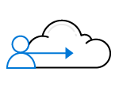

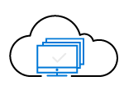
Microsoft Enterprise Mobility + Security
Identity-driven innovations help you stay secure and productive on your favorite apps and devices.
Control identity +
access in the cloud
Manage mobile
devices + apps
Get identity-driven security
Protect your information
Virtualize your desktops
Notes:
Control identity + access in the cloud
Centrally manage single sign-on across devices, your datacenter, and the cloud.
Get identity-driven security
Comprehensive, intelligent protection against today's advanced attacks.
Manage mobile devices + apps
Securely manage apps and data on iOS, Android, and Windows from one place.
Protect your information
Intelligently safeguard your corporate data and enable secured collaboration.
Virtualize your desktops
Efficiently deliver and manage Windows desktops and apps on all devices.

Slide 18



Securing Office 365 with EMS (Enterprise mobility + Security)
Azure Active Directory
Microsoft Intune
Azure Information Protection
Cloud App Security

Slide 19

Microsoft FastTrack M365 powered device A catalyst for rapid, effective deployments and user adoption
Success Plan
Proof of Concept
Product Pilot
Best Practices
DRIVE VALUE
ENVISION
ONBOARD
Core benefit of Microsoft 365, included with purchase: Windows 10, Office 365 & EMS
Guidance & vetted best practices: Deployment to user adoption
Partner ecosystem and referrals: Deployment expertise
End-to-end approach: A coordinated approach to deployment
Repeatable model: One pane of glass to view stages of your ongoing deployments
FastTrack.microsoft.com
METHODOLOGY &
RESOURCES
TOOLS &
INSIGHTS
EXPERTS
End User Adoption
Up-to-date Servicing
Notes:
The Microsoft 365 powered device has a virtuous cycle of product improvement, feature roadmaps, coordinated support across the entire environment and a partner ecosystem to help you execute and manage the enterprise
This approach represents a shift from a more workload- or product-focused deployment strategy to a coordinated one across the ecosystem
Microsoft provides scale, a repeatable process that is included with Microsoft 365
Don’t spend your resources and time on desktop management – let Microsoft catalyze your deployment

Slide 20
FastTrack for Microsoft 365 powered device
FastTrack.Microsoft.com
Customer Success Plan
Tools, updated deployment guidance & core assistance
Accelerate Proof of Concept
Accelerate Pilot
Windows 10, Office 365 ProPlus, EMS
Non-production Proof of Concept
Initial rollout
500 seats deployed
Partner/MCS led with funding
Partner/MCS led, FastTrack Center Support for funded engagements
Notes:
FastTrack.Microsoft.Com is the center of the universe for partners in FY18. Starting with a customer success plan, created by YOU, FastTrack paves the way to provide both Proof of Concept (non production) and Pilot (initial, 500 seat) rollouts to your customers.

Slide 21
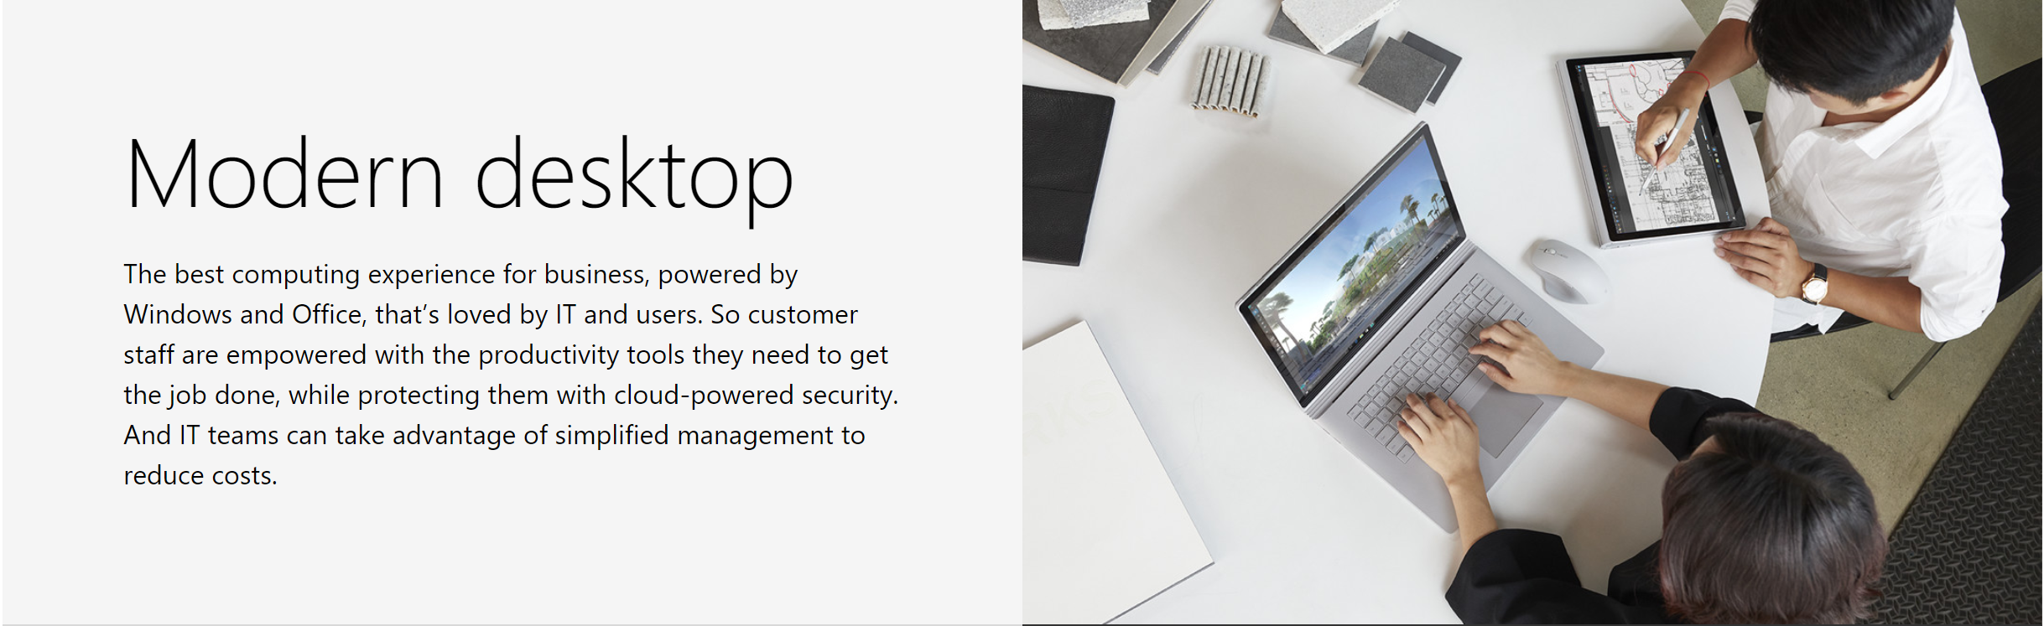
Microsoft 365 - Device Concepts
Notes:
Control identity + access in the cloud
Centrally manage single sign-on across devices, your datacenter, and the cloud.
Get identity-driven security
Comprehensive, intelligent protection against today's advanced attacks.
Manage mobile devices + apps
Securely manage apps and data on iOS, Android, and Windows from one place.
Protect your information
Intelligently safeguard your corporate data and enable secured collaboration.
Virtualize your desktops
Efficiently deliver and manage Windows desktops and apps on all devices.

Slide 22

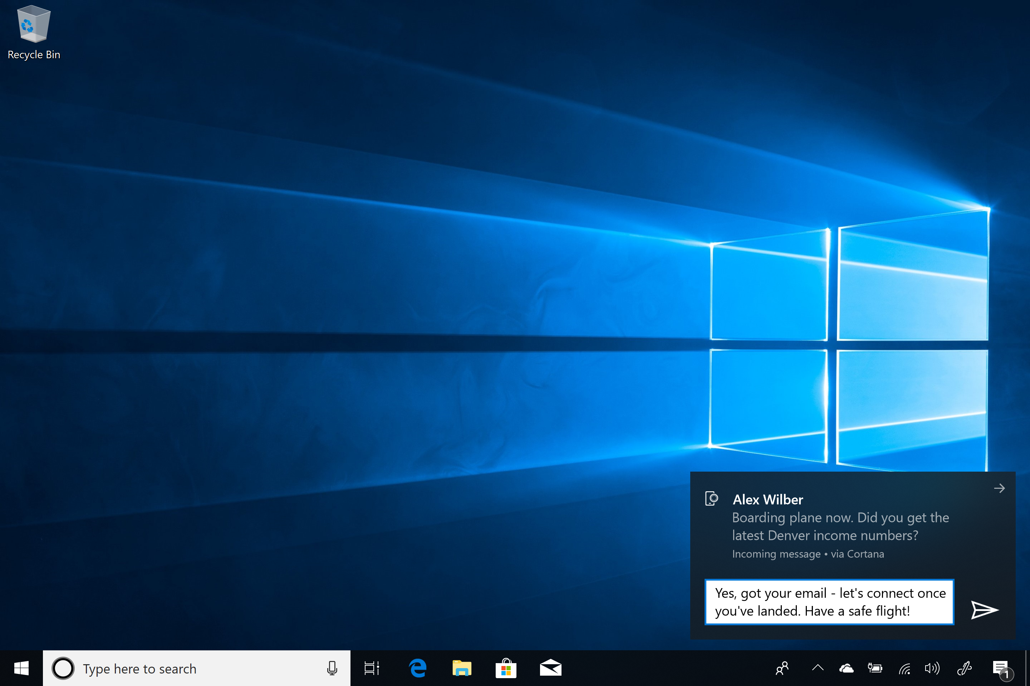
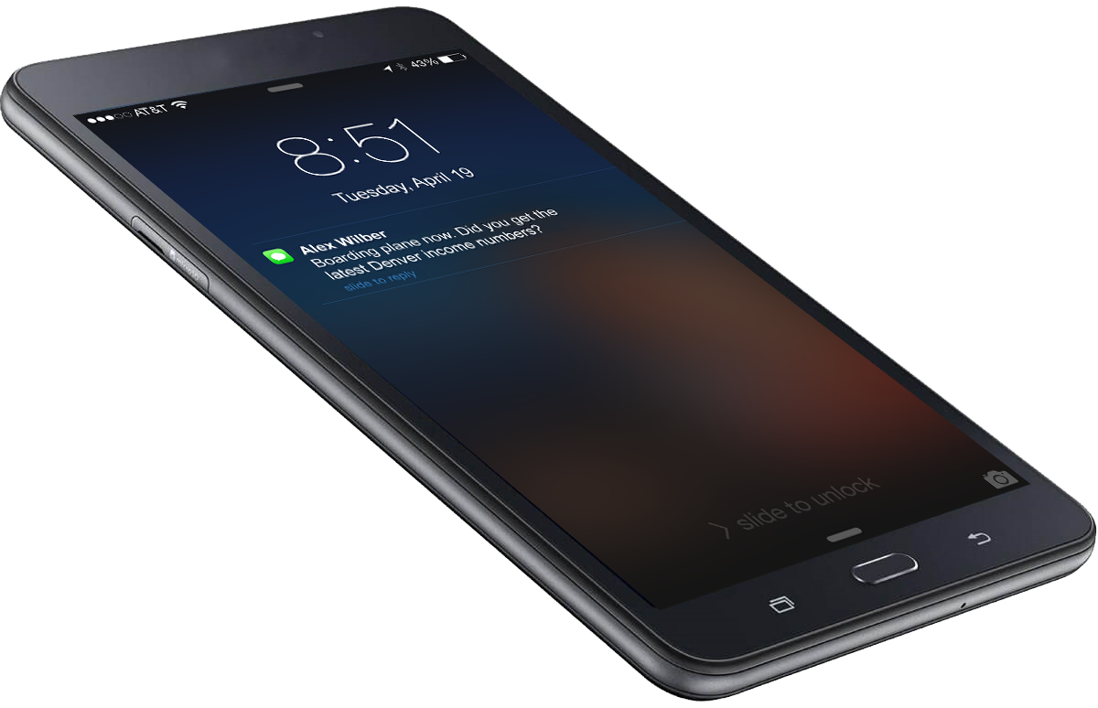
Mobility and access from anywhere
Seamlessly work across your iPhone or Android device
Access your Office docs on any device and any platform
Stay productive anywhere with online versions of Office apps
Browse faster and safer in Microsoft Edge
Notes:
Knowing that the phone is a big part of the way people work today, the modern desktop is designed to work well with both Android and iPhones.
Seamlessly work across devices: with features like Continue on PC, users can easily move from one device to another, continuing an activity right where they left off. Microsoft Edge creates continuous browsing for Windows 10 users across their devices, syncing content and data seamlessly and safely. Users can even send and receive SMS text messages from their computer.
Access your work on any device and any platform: users can access Office 365 files and data from any activated device, anywhere, on any platform, at any time. They can share and collaborate on documents directly from OneDrive, and provide access to anyone in the organization.
Stay productive anywhere with online versions of Office apps: utilize a rich “near-desktop” experience, work anywhere with an internet connection, and modify documents on the go
Microsoft Edge is designed for Windows 10 to offer users faster, safer ways to get work done, across their PC and their phone. Built-in tools make it easy for users to keep tabs organized, write on web pages for simple idea sharing and collaboration, and ask Cortana⁴ to find answers or pull in web information without leaving the site they’re are on.
⁴Cortana available in select markets; experience may vary by region and device. Cortana app required for Android and iOS devices (Requires Android version 4.1.2 or higher, or iPhone 4 with iOS 8.0 or higher).
“…”
Key points to land
Text
Text
Text

Slide 23

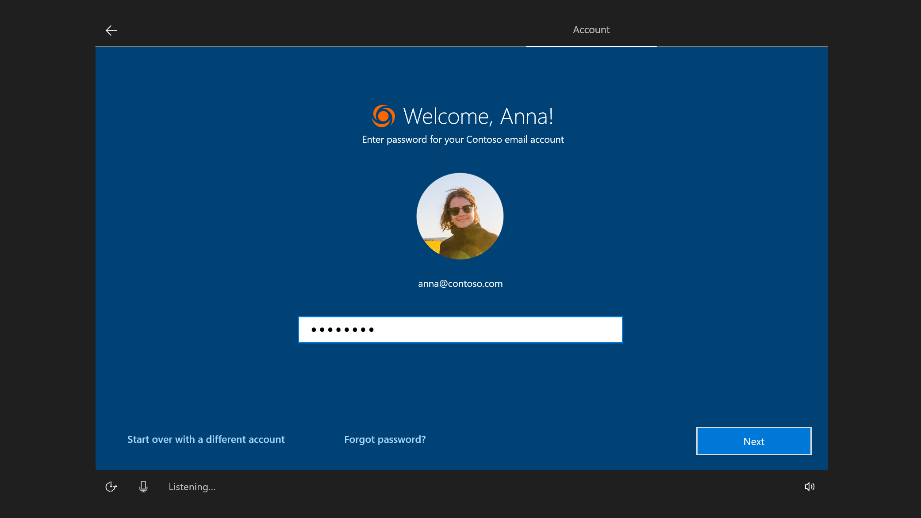
Frictionless, out-of-the-box experience With a self-service experience, lowering help desk costs
Windows Autopilot Get new devices up and running fast, without reimaging, all powered by the cloud
Automatically configure settings, security policies and install apps like the Office 365 apps
Windows Subscription Activation Easily step up from Windows 10 Pro to Windows 10 Enterprise or Windows 10 Education, without rebooting
Notes:
With Windows 10, IT can deliver enterprise-ready devices with a self-service experience, lowering help desk costs.
The hero feature here is Windows Autopilot, which allows IT to get new devices up and running fast, without reimaging, all powered by the cloud. Automatically configure settings, security policies and install apps like Office 365.
Windows Autopilot¹ takes new device from the box to fully configured and managed from the cloud, with minimal IT, or end user effort required. Powered by Azure Active Directory and Microsoft Intune² it automatically configures settings, security policies and installs apps like Office 365² apps.
Easily step up from Windows 10 Pro to Windows 10 Enterprise or Windows 10 Education, without even rebooting, through Windows 10 Subscription Activation. Users don't need to give their device to IT, instead IT can upgrade their device remotely. Take advantage of Azure Active Directory to assign Windows 10 Enterprise E3 or E5 licenses (or the Education and Microsoft 365 equivalents) to members of your organization, using the same methods available for Office 365 and EMS. When combined with Windows Autopilot, you can ensure that new devices will automatically step up, enabling additional functionality.
<click>
¹Requires Azure Active Directory and Intune to complete Hybrid Azure Active Directory Join. Sold separately.
²Sold separately.
“A self-service experience, lowering help desk costs.”
Key points to land
Windows Autopilot¹: get new devices up and running fast, without reimaging, all powered by the cloud; automatically configure settings, security policies and install apps like Office 3652
Windows Subscription Activation: easily step up from Windows 10 Pro to Windows 10 Enterprise or Windows 10 Education, without rebooting
Windows 10 for Enterprise

Slide 24
LAB 01 – Hands-on Lab introduction
Tips
IE First, then InPrivate, then other Browsers
You will be creating a NEW (never been used) Microsoft Account, DO NOT USE you personal Microsoft Account
Always click Done ☺
Make Sure you are in the right Domain (no the default OnMicrosoft)
https://m365.learnondemand.net

Slide 25
Thank You

